Slide 1

IBM
The Backbone of modern
computing and innovations
around the world

Slide 2
Table of Contents
History
Beginnings
Famous Inventions
Divisions and Projects
Mainframes
3xx Architecture
Z/Architecture
Usage
Deployments
Field Advancements

Slide 3
History
How did IBM gets its foot into the Industry, how did they become one of the largest tech companies and how did it all being?

Slide 4
Beginnings of IBM
Founded in 1911 as CTR in Endicott, NY
Manufactured Tabulating Machines
Renamed in 1924 as IBM
Entered the Mainframe market in 1950
Entered the Personal C0mputer market in ’81

Slide 5
Famous Inventions
ATM
Hard Disk
Floppy Disks
Magnetic Stripe
SQL
Dynamic RAM
Barcodes

Slide 6
Divisions and Projects
Current Divisions
System/Z Mainframes
Cloud Computing
Power-ISA Hardware
Artificial Intelligence
Data and Analytics
Cybersecurity
Internet of Things

Slide 7
Divisions and Projects
Past Divisions
Printers and Keyboards
Spun off into Lexmark
Personal Computers and Enterprise Servers
Sold in 2005 and 2014 to Lenovo
Managed Infrastructure
Spun off into Kyndryl
Watson Health AI
Sold to Francisco Partners (Private Equity)

Slide 8
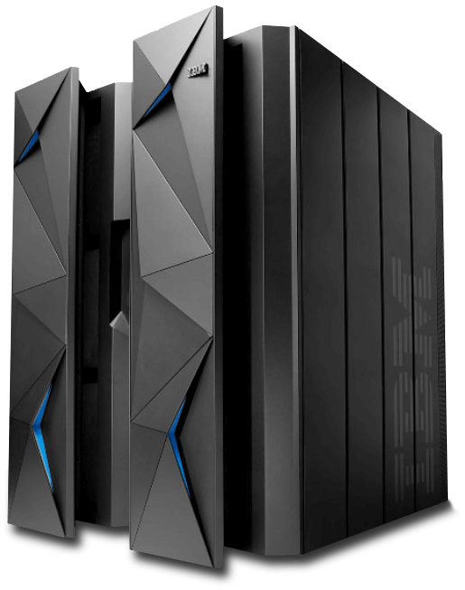
Mainframes
The life blood of supercomputers around the world, IBM’s bread and butter when it comes to powerful and power hungry computing.

Slide 9
300-Series Architecture
Massive redesign from 1400 and 700 series
32-Bit Complex-ISA
Introduction of the 8-bit byte
Byte-addressable memory
Emulation support for previous generations

Slide 10
Z/ Architecture
64-Bit Complex-ISA
300-series emulation (ESA/390 after z13)
Non-Java Applications have a 2GB limit
Officially supports Linux
Virtualization Support

Slide 11
Usage of IBM Mainframes
Where are they used? What are they used for? Why would you consider using one? And what did it bring to the table for modern computing?

Slide 12
Deployments
Banks
Insurance
Healthcare and Hospitals
Aviation Industry
Retail and Online E-Commerce
Military
Academics and Research
Supercomputers
Governments

Slide 13
Field Advancements
64-Bit Instruction Sets
8-Bit Byte
Byte-Addressable Memory Pages
Virtualization
High Speed Intercom
Redundancy

Slide 14
Miscellaneous
Sources and Link to Slides and Notes online

Slide 15
Sources
https://en.wikipedia.org/wiki/IBM
https://en.wikipedia.org/wiki/IBM_System/360_architecture
https://en.wikipedia.org/wiki/Z/Architecture
https://en.wikipedia.org/wiki/IBM_System/370
https://en.wikipedia.org/wiki/IBM_System/390

Slide 16
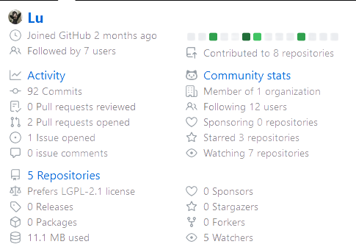
Link to the Slides and Notes
https://github.com/EthernalRaine/uni

